Slide 1
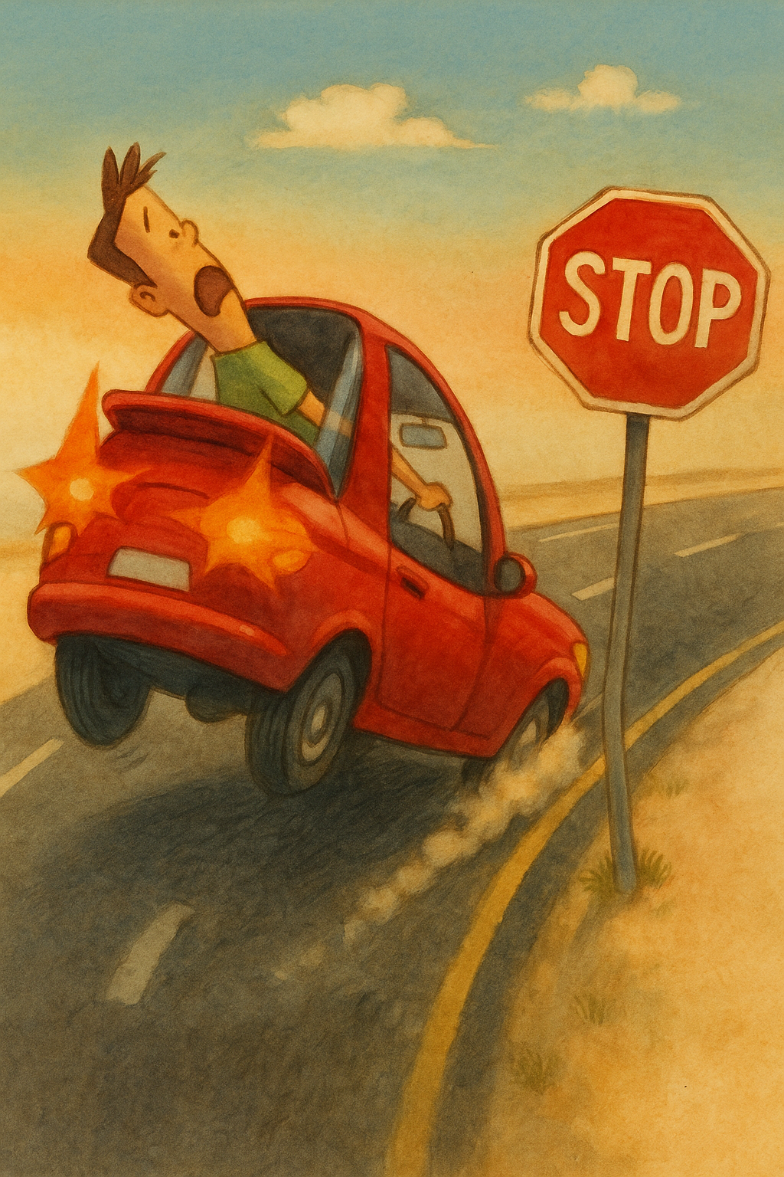
Stop Sign Detection
Using Machine Learning
Group: 08
Abdul Alim Rakib
Sumaya Shimu Rima
Shakib Ahamed
Md Naimur Rahman

Slide 2
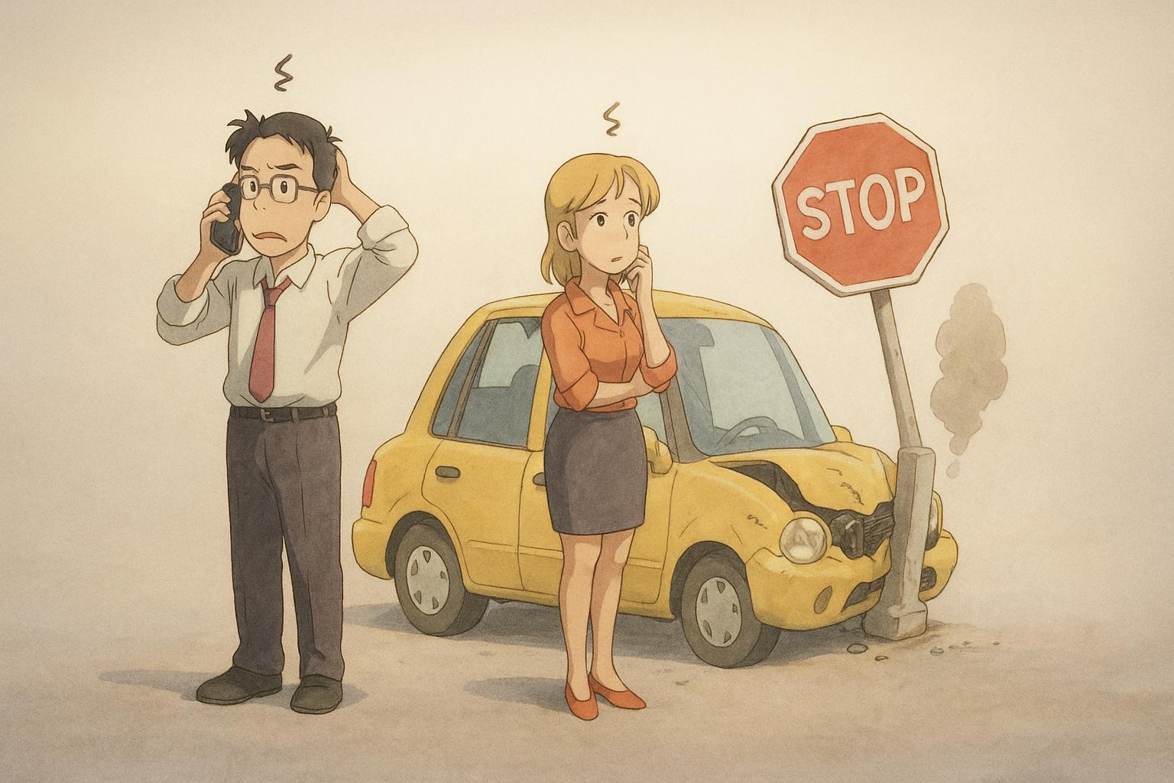
Introduction
Goal
Detect stop signs with deep learning
Why
Enhance autonomous driving, smart traffic
Methods
Multiple Methods, KNN, MLP, CNN
Progress
Model trained with augmented datasets
Aim
Demonstrate effectiveness in traffic recognition

Slide 3



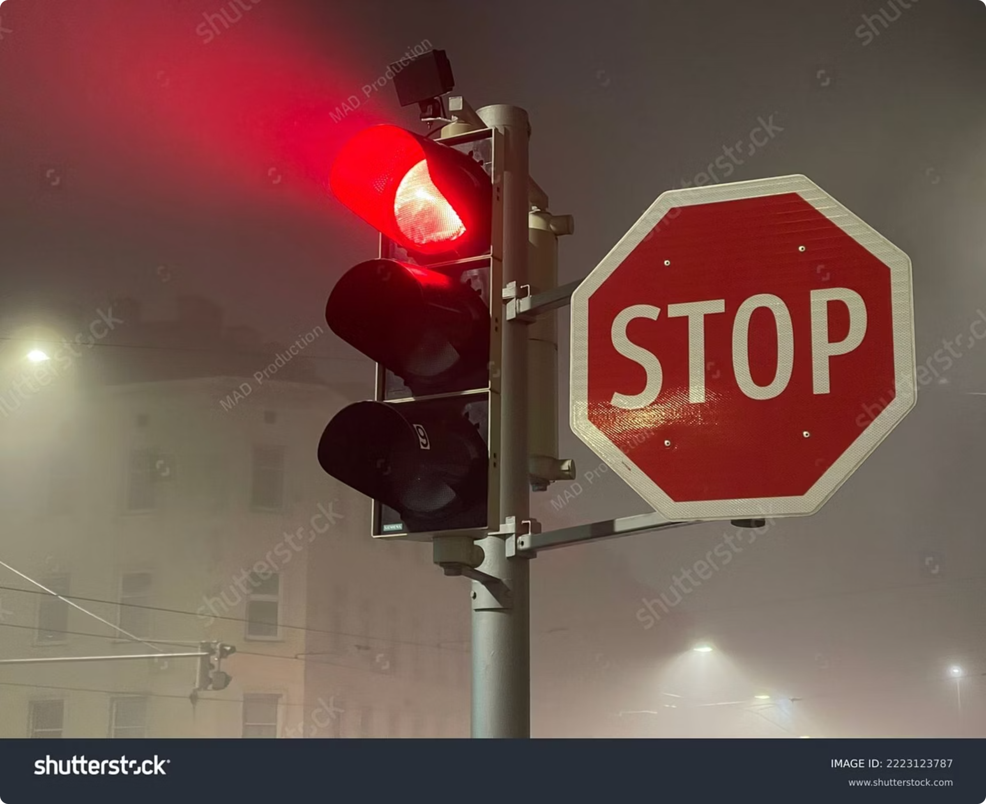

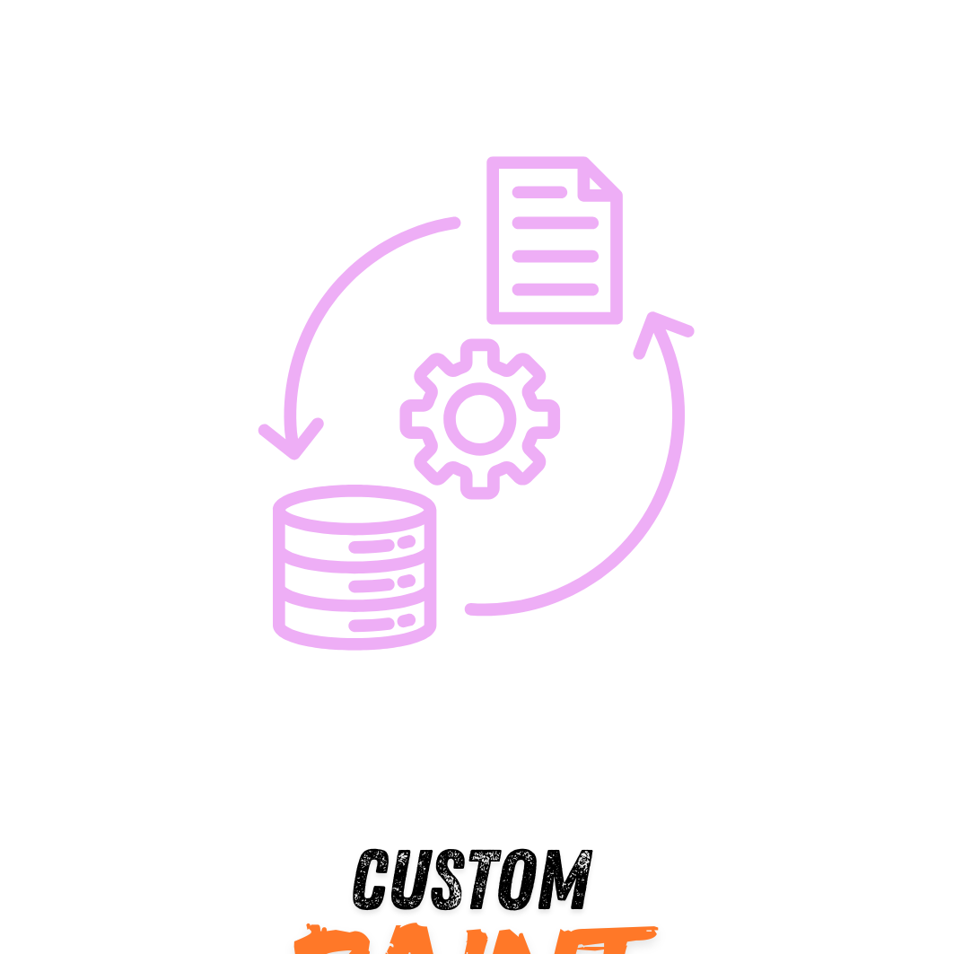
Features
ML MODEL IMPLEMENTATION
Real-time Recognition
Stop sign detection with machine learning.
Real-time object recognition from images
Data Augmentation
Data Extraction
Preprocessing for improved model performance.
Model training, validation, and performance assessment.
Deployment for real-world use cases.
Used HOG and LBP to extract shape and texture features.
Combined features into a single vector for each image.
Applied PCA to reduce dimensions and improve efficiency.

Slide 4

Language
Python
Methods
KNN, MLP, CNN, etc.
GROUP:08: Md. Naimur Rahman, Abdul Alim Rakib, Sumaya Shimu Rima Shakib Ahamed

Slide 5
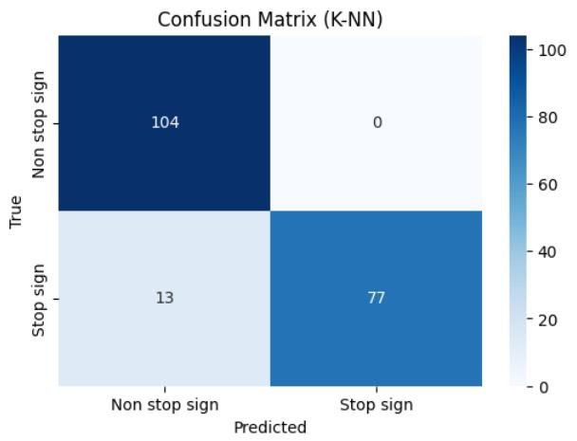
Results & Evaluation
Precision: Accuracy of positive detections.
Recall: Ability to find all positive samples.
F1-score: Harmonic mean of precision and recall.
Cross-validation accuracy: 92.76%
Test set accuracy: 95.36%
GROUP:08: Md. Naimur Rahman, Abdul Alim Rakib, Sumaya Shimu Rima, Shakib Ahamed

Slide 6




Future Enhancements
Model Performance
Advanced datasets, testing on unseen data
Model Selection
Add CNN, MLP, SVM - Most suitable model for real-world deployment
Optimize Speed
Optimized processing speed for real-time detection

Slide 7


Conclusion
Built stop sign detection with traditional ML
Initial results show effectiveness
Plan: Test more models, improve accuracy
GROUP:08: Md. Naimur Rahman, Abdul Alim Rakib, Sumaya Shimu Rima, Shakib Ahamed

